Slide 1


OPER 679 Lesson 14
Dr. Nathan Gaw
Assistant Professor
Department of Operational Sciences
Air Force Institute of Technology
The views expressed in this presentation are those of the author(s) and do not reflect the official policy or position of the United States Air Force, the Department of Defense, or the United States Government.

Slide 2
Previously
We learned how to…
Define multicollinearity and explain why it is a problem
Describe the sources of multicollinearity
Diagnose multicollinearity in a dataset using several approaches
Explain the advantages and disadvantages of the different diagnostic approaches
Employ ridge regression and principal component regression to mitigate the effects of multicollinearity
Text Covered: Ch. 9.1-9.5

Slide 3
Lesson Objectives
At the end of the session, students will be able to…
Employ a two-stage approach for model selection given a large number of potential predictors
Explain the consequences of model misspecification
Rank model subsets using criteria for evaluating subset regression models
Explain the risk associated with variable selection via stepwise regression
Text Covered: Ch. 10.1-10.3

Slide 4
Variable Selection Strategy
What we already know how to:
Obtain regression parameter estimates
Perform appropriate hypothesis tests
Check for violations of assumptions or other model inadequacies
Apply a variety of approaches to mitigate the effects of what we find in Step 3 above.
Transformations
Model adjustments
In the above process, we are implicitly assuming that, in Step 1, we are obtaining estimates for the correct set of regression parameters
→ This may or may not be a good assumption!
Normality
Constant Variance
Linearity
Multicollinearity
Influential observations

Slide 5
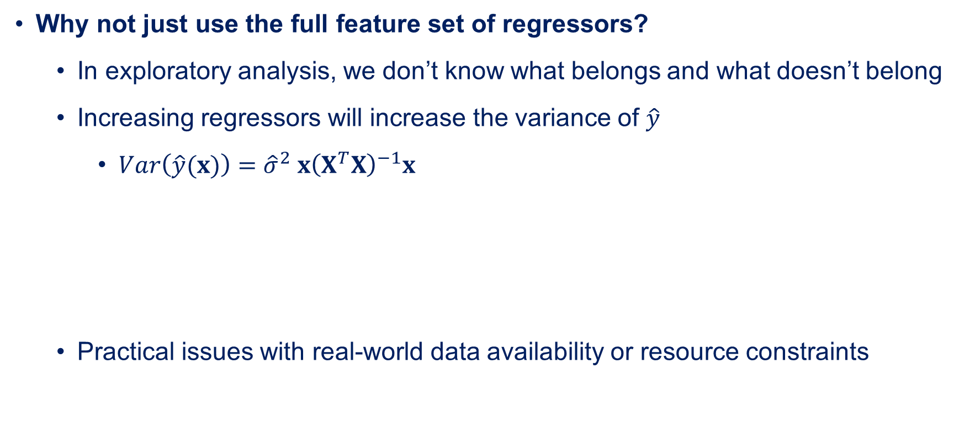
Pre-Discussion: Feature Set Selection
Why not just use the full feature set of regressors?
In exploratory analysis, we don’t know what belongs and what doesn’t belong
Increasing regressors will increase the variance of $\hat{y}$
$Var\left(\hat{y}(x)\right)={\hat{σ}}^{2} x{\left(X^{T}X\right)}^{−1}x$
Practical issues with real-world data availability or resource constraints
Can get smaller as you add regressors
Always gets bigger as model size gets larger

Slide 6
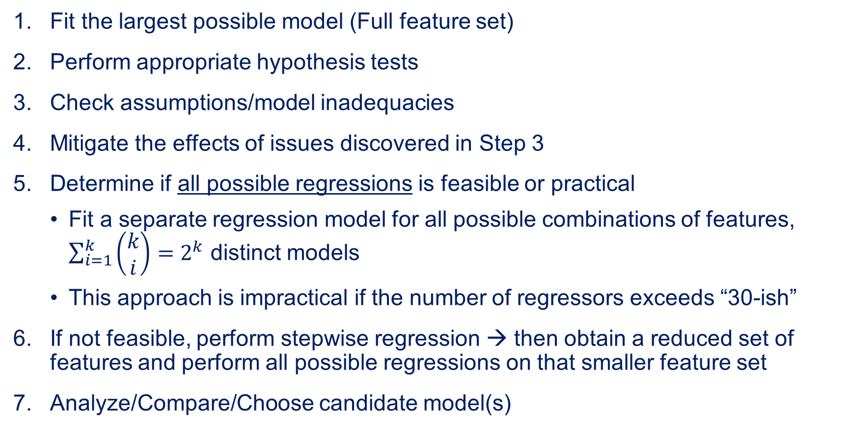
Adjusted Variable Selection Strategy
Fit the largest possible model (Full feature set)
Perform appropriate hypothesis tests
Check assumptions/model inadequacies
Mitigate the effects of issues discovered in Step 3
Determine if all possible regressions is feasible or practical
Fit a separate regression model for all possible combinations of features, $\sum_{i=1}^{k}{\left(\begin{aligned}k \\ i\end{aligned}\right)=2^{k}}$ distinct models
This approach is impractical if the number of regressors exceeds “30-ish”
If not feasible, perform stepwise regression → then obtain a reduced set of features and perform all possible regressions on that smaller feature set
Analyze/Compare/Choose candidate model(s)

Slide 7

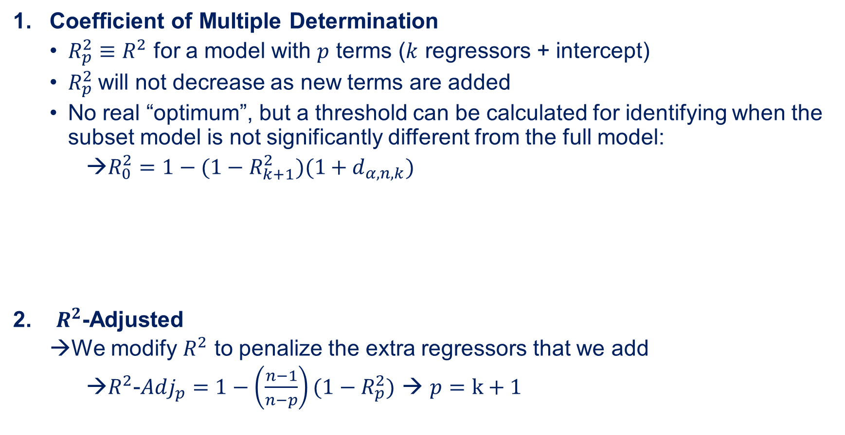
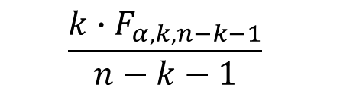
Criteria to Evaluate Subset Models
Coefficient of Multiple Determination
$R_{p}^{2}≡R^{2}$ for a model with $p$ terms ($k$ regressors + intercept)
$R_{p}^{2}$will not decrease as new terms are added
No real “optimum”, but a threshold can be calculated for identifying when the subset model is not significantly different from the full model:
→$R_{0}^{2}=1−(1−R_{k+1}^{2})(1+d_{α,n,k})$
$R^{2}$-Adjusted
We modify $R^{2}$ to penalize the extra regressors that we add
$R^{2}$-$Adj_{p}=1−\left(\frac{n−1}{n−p}\right)(1−R_{p}^{2})$ → $p=k+1$
$R^{2}$ from full model
$$\frac{k∙F_{α,k,n−k−1}}{n−k−1}$$
# of regressors in subset

Slide 8

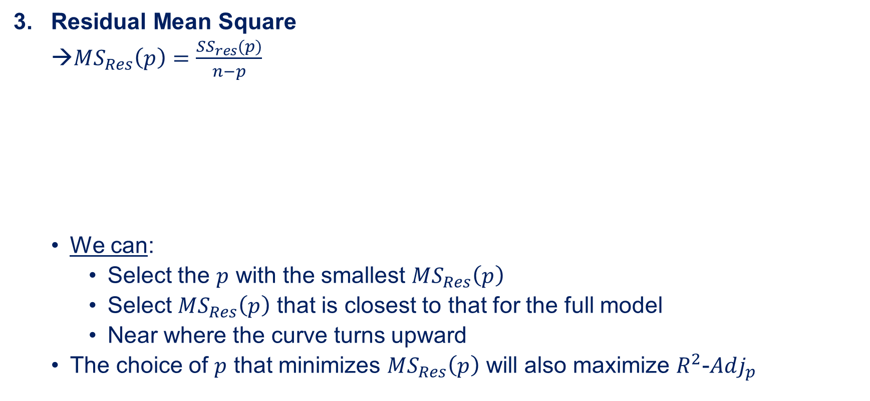

Criteria to Evaluate Subset Models
Residual Mean Square
$MS_{Res}\left(p\right)=\frac{SS_{res}(p)}{n−p}$
We can:
Select the $p$ with the smallest $MS_{Res}\left(p\right)$
Select $MS_{Res}\left(p\right)$ that is closest to that for the full model
Near where the curve turns upward
The choice of $p$ that minimizes $MS_{Res}\left(p\right)$ will also maximize $R^{2}$-$Adj_{p}$
This will usually decrease (never increases)
This always decreases
$$MS_{Res}\left(p\right)$$
$$p$$

Slide 9

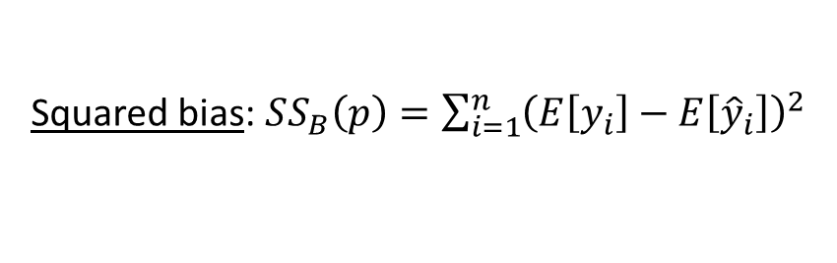
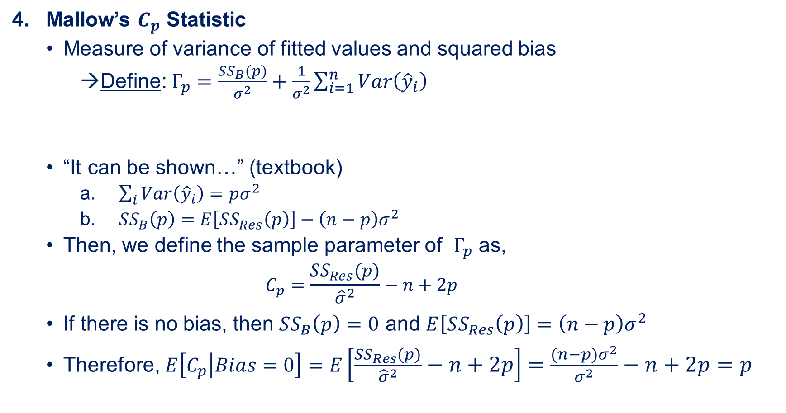
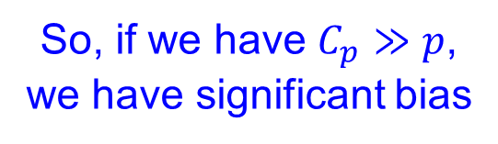
Criteria to Evaluate Subset Models
Mallow’s $C_{p}$ Statistic
Measure of variance of fitted values and squared bias
Define: $Γ_{p}=\frac{SS_{B}(p)}{σ^{2}}+\frac{1}{σ^{2}}\sum_{i=1}^{n}{Var\left({\hat{y}}_{i}\right)}$
“It can be shown…” (textbook)
$\sum_{i}{Var\left({\hat{y}}_{i}\right)=pσ^{2}}$
$SS_{B}\left(p\right)=E\left[SS_{Res}\left(p\right)\right]−\left(n−p\right)σ^{2}$
Then, we define the sample parameter of $Γ_{p}$ as,
$$C_{p}=\frac{SS_{Res}(p)}{{\hat{σ}}^{2}}−n+2p$$
If there is no bias, then $SS_{B}\left(p\right)=0$ and $E\left[SS_{Res}\left(p\right)\right]=\left(n−p\right)σ^{2}$
Therefore, $E\left[C_{p} | Bias=0\right]=E\left[\frac{SS_{Res}\left(p\right)}{{\hat{σ}}^{2}}−n+2p\right]=\frac{\left(n−p\right)σ^{2}}{σ^{2}}−n+2p=p$
Squared bias: $SS_{B}\left(p\right)=\sum_{i=1}^{n}{{\left(E\left[y_{i}\right]−E\left[{\hat{y}}_{i}\right]\right)}^{2}}$
So, if we have $C_{p}≫p$, we have significant bias

Slide 10

Criteria to Evaluate Subset Models
Mallow’s $C_{p}$ Statistic (continued)
Small $C_{p}$ desired
If ${\hat{σ}}^{2}>σ^{2}$, then $C_{p}<0$ is possible but nonsensical
Plot $C_{p}$ vs. $p$ for values of $p$ to visualize and select $p$

Slide 11
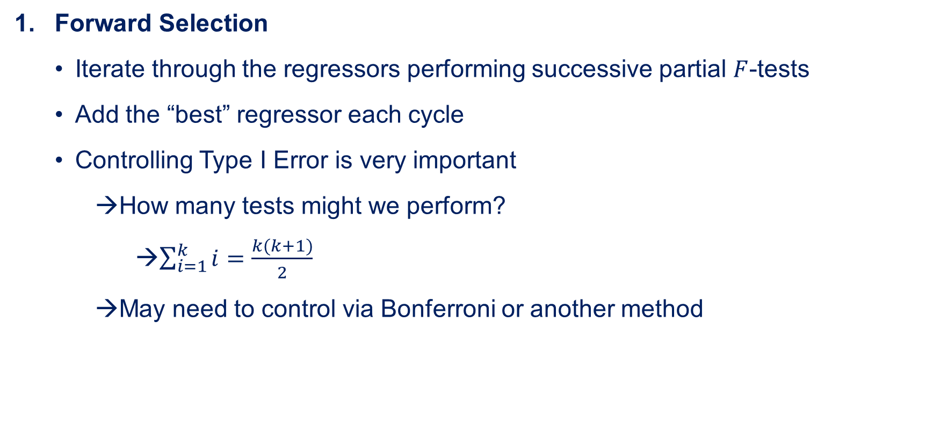
Stepwise Regression
Forward Selection
Iterate through the regressors performing successive partial $F$-tests
Add the “best” regressor each cycle
Controlling Type I Error is very important
How many tests might we perform?
$\sum_{i=1}^{k}{i}=\frac{k(k+1)}{2}$
May need to control via Bonferroni or another method

Slide 12
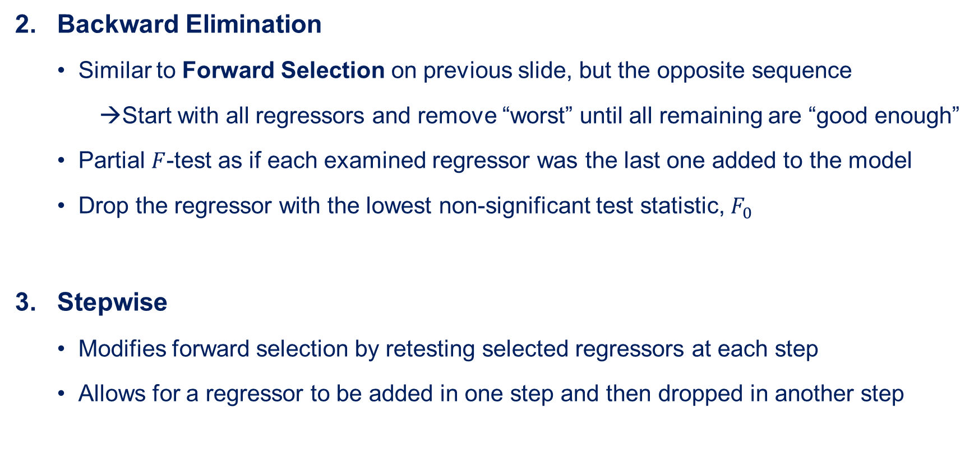
Stepwise Regression
Backward Elimination
Similar to Forward Selection on previous slide, but the opposite sequence
Start with all regressors and remove “worst” until all remaining are “good enough”
Partial $F$-test as if each examined regressor was the last one added to the model
Drop the regressor with the lowest non-significant test statistic, $F_{0}$
Stepwise
Modifies forward selection by retesting selected regressors at each step
Allows for a regressor to be added in one step and then dropped in another step

Slide 13
Closing Thoughts
Be careful with stepwise regression
Does not give “optimal” model
Likely many good models
Regressor inclusion and hypothesis tests depend on what is already in the model
→Order matters
Forward and Backward approaches will probably give different final models
Once we have a few candidate models, we need to thoroughly analyze and compare them.
Model adequacy
“Eyeball” test: Do the coefficients make sense? Do the regressors?
Are the models suitable for their intended purpose?
Is multicollinearity (still?) a problem?
Predictive capability on a fresh dataset
Are subsequent transformations necessary?

Slide 14
Lesson Objectives
At the end of the session, you should now be able to…
Employ a two-stage approach for model selection given a large number of potential predictors
Explain the consequences of model misspecification
Rank model subsets using criteria for evaluating subset regression models
Explain the risk associated with variable selection via stepwise regression
Text Covered: Ch. 10.1-10.3

